Slide 1

Phonics at Al-Islamia
Phonics and Decoding

Slide 2
What is Phonics?
According to the National Literacy Trust:
'Phonics is a way of teaching children how to read and write. It helps children hear, identify and use different sounds that distinguish one word from another in the English language. ... Phonics involves matching the sounds of spoken English with individual letters or groups of letters.'

Slide 3
Why the Big Deal?
A scrutiny (deep dive) into Reading is a mandatory aspect of every Ofsted inspection, because 'it’s so important that children learn to read fluently as quickly as possible. Inevitably, fluent readers will learn more, because they can read and gain knowledge for themselves.' (Gill Davies, Deputy Director, Ofsted, Nov 2019).
According to the DfE, phonics should be 'the prime approach to decoding print' (DfE, April 2021).
Thus, when Reading is reviewed, the delivery and effectiveness of Phonics teaching will also be assessed and observed.

Slide 4
SSP – Systematic, Synthetic Phonics
We use the highly-acclaimed and well-known Letters and Sounds Phonics scheme of work
Synthetic Phonics – the process of matching isolated graphemes with phonemes, before introducing 'blending' of multiple phonemes to create whole words
Systematic Phonics – delivering phonics content in a coherent, defined sequence

Slide 5
Phases
Letters and Sounds is divided into 5 phases, to teach 42 phonemes (sounds)
Each phase has a clear outline of the content that is taught within it
The following slides will guide you through the basic outline of each phase

Slide 6
Phase 1
Introduces early speakers (ages 3-4) to sound discernment, e.g., challenging children to isolate a specific sound/phoneme from within a selection of words
Encourages oral segmenting to encourage mental blending of environment-related words, e.g., r-oa-d, c-a-r, etc

Slide 7
Phase 2:
Set 1: s, a, t, p
Set 2: i, n, m, d
Set 3: g, o, c, k
Set 4: ck, e, u, r
Set 5: h, b, f, ff, l, ll, ss
Begins in F2
Taught over 5 weeks, with one set per week
Children will apply their oral 'blending skills' to begin reading simple words using the taught sounds, e.g., 'a-t' is 'at' (Week 1) to 'h-u-ff' is 'huff' (Week 5)
Technical vocabulary will be taught as well: grapheme, phoneme, digraph, segment, blend
Children will also be introduced to some 'tricky' words – high frequency words that they will not yet be able to decode: go, no, to, into, the, I
Initial demonstration of sounds as graphemes
Short sentences will begin to be introduced by the end of Phase 2, e.g. I huff and I puff. I got a pack.

Slide 8
Phase 3:
Set 6: j, v, w, x
Set 7: y, z, zz, qu
Consonant digraphs: ch, sh, th, ng
Vowel digraphs: ai, ee, igh, oa, oo, ar, or, ur, ow, oi, ear, air, ure, er
Continues in F2
25 new graphemes over a 12-week period
Children will also learn the alphabet
Consonant digraphs are 'two consonant letters that make one sound'
Vowel digraphs are 'two vowel letters that make one sound'
Phase 3 tricky words: he, she, we, me, be, was, you, they, all, are, my, her
Children will now be segmenting and blending words to read sentences such as: The wax is hot. The cow rang the bell.

Slide 9
Phase 4
No new sounds will be taught as children will have been taught at least one grapheme for each of the 42 phonemes
Children will be focusing on a mixture of CVC (consonant-vowel-consonant) words, e.g., milk, string, etc.
They will also be reading two-syllable words, e.g. woodland, beaker
Tricky words: said, have, like, so, do, some, come, were, there, little, one, when, out, what
Phase 4 will be taught for the remainder of the F2 year (15 to 20 weeks)

Slide 10
Phase 5
Phase 5 is expected to be delivered over the entire Year 1 period
By this point, segmenting and blending with the taught graphemes for the 42 phonemes is expected to be secure
During Phase 5, children will be taught alternative graphemes for phonemes, e.g., the options available to spell the /ay/ sound: 'a', 'ai', 'ae', 'a-e' and 'ay'

Slide 11
Using Phonics to Decode (Read)
black

Slide 12
Using Phonics to Decode (Read)
hinder

Slide 13
Using Phonics to Decode (Read)
I slept in a cushy treehouse.

Slide 14
Using Phonics to Decode (Read)
I slept in a cushy treehouse.

Slide 15
Year 1 2021-2021
Missed 7 months of face-to-face teaching over the last 12 months
Segmenting and blending is still a skill that some children struggle with
Children who are still struggling with grapheme recognition, blending and segmenting, will struggle with accessing the rest of the curriculum

Slide 16
Next Steps in School
In-class differentiation and support
Reading intervention focusing on phoneme recognition and blending
Phase 3 and 4 review and support

Slide 17
Next Steps at Home
Segmenting
Segmenting words
Dictating
Dictating shopping lists
Encouraging
Encouraging children to read shopping list
Using
Using decoding to help children read stage book
Challenging
Challenging your child to read/spell the words on their flashcards

Slide 18
What If...
I don’t speak English very well?
If you can read the Latin alphabet, become familiar with how the graphemes sound in English.
Use accredited YouTube videos to learn how to pronounce each phoneme.
The DfE have a dedicated Letters and Sounds YouTube channel: https://www.youtube.com/channel/UCP_FbjYUP_UtldV2K_-niWw

Slide 19
What If...
I don’t speak know how to decode?
We will provide a phoneme/grapheme chart.
First read the sentence/word yourself.
Identify the phonemes that make up each word.
Match the phonemes to the grapheme using the Letters and Sounds chart
Use Google to find out pronunciations

Slide 20
What If...
Blending is to recognise and the 'squeeze' the sounds in a word 'together'
You can demonstrate/practice blending by:
- identifying the sounds/phonemes within a word and saying them progressively faster, e.g. m (pause) a (pause) t -> m/a/t -> mat
- exaggerate the sounds/phonemes within a word so they roll together: mmmmmmmm-aaaaaaaaa-tttttttttt -> mat
- blend the first two sounds/phonemes, and then 'add' additional ones, e.g., m-a -> ma; ma-t-> mat
I'm not sure how to blend?

Slide 21
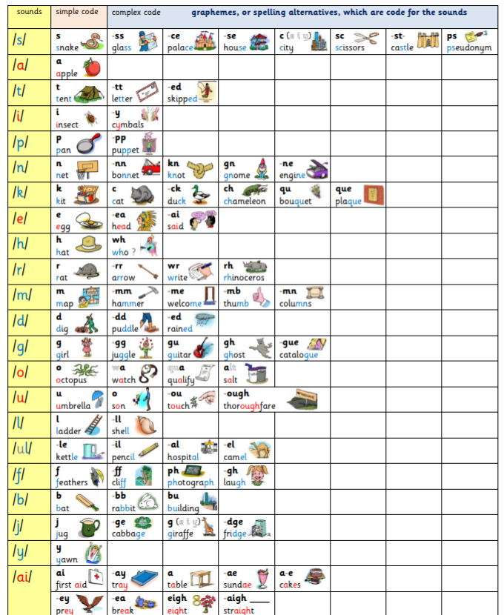
Grapheme/Phoneme Chart

Slide 22
Ease of Access
The following material will be uploaded to the Resources area of the Primary Curriculum Page:
The YouTube link to the DfE's Letters and Sounds playlist
A 2-page PDF of the grapheme/phoneme correspondence chart to download

Slide 23
JazakumAllah Khair
Thank you for your time and patience
Questions will be answered at this point – please insert them into the chat
As always, when home and school continue to communicate, our children will benefit

